Slide 1

Topic
Renting Prices Analyses in Big Cities of China
Zhang Yiming (1801212981)
Yu Xihang(1801212965)
Wang Bingquan (1801212932)
Liu Anyi (1801212888)

Slide 2

CONTENTS
PART 1
PART 2
PART 3
PART 4
Introduction
Data Crawling & Storage
Feature Engineering
Model

Slide 3
CONTENTS
PART 1
PART 2
PART 3
PART 4
Introduction

Slide 4
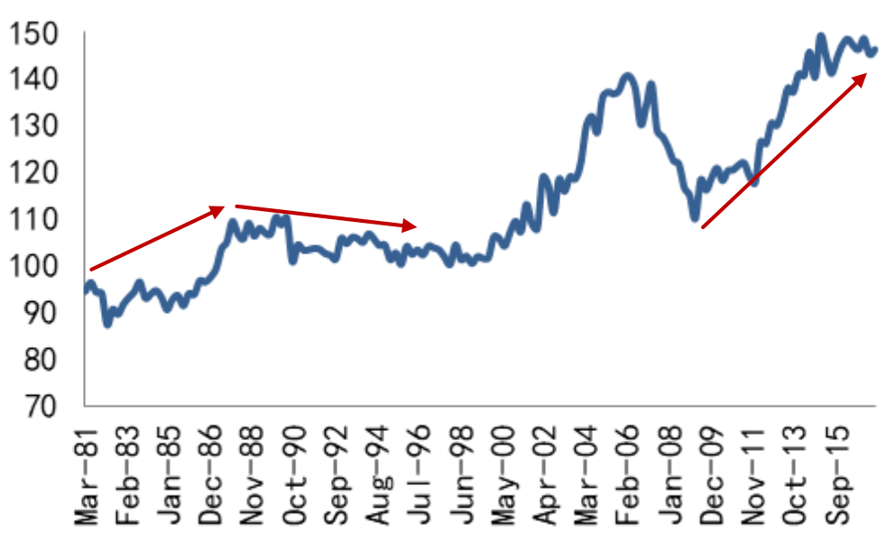
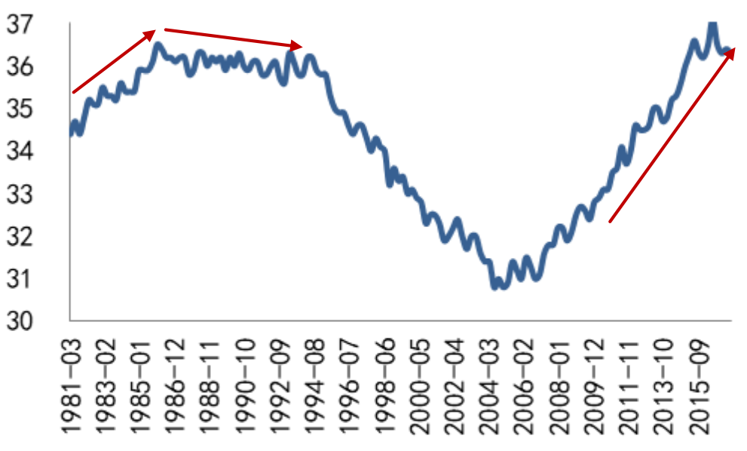
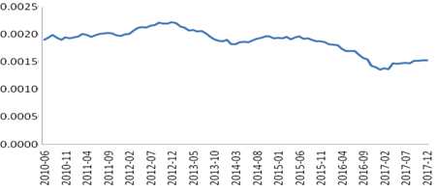
Part 1. Introduction
Motivation: Analyze the behavior & price of renting
By the end of 2018, the total number of renters in China reached 190 million, and the market size reached more than 1 trillion yuan.
The percentage of rental families will increase as the Housing Price-to-Income Ratio
By 2030, according to the forecast of Housing Construction Commission, domestic rental population will reach 270 million, and the market size will exceed 4.6 trillion
Price-to-rent ratio in China has long been below 2%, however the ratio in America is more than 4%
Housing Price-to-Income Ratio of US (1981-2015)
Percentage of Rental families in US (1981-2015)
Price-to-rent ratio in China
Source：Guotai Junan Security

Slide 5
Part 1. Introduction
Our Target
Use scrapy framework in python to crawl the renting information on Anjuke.com and store them in suitable forms.
Firstly provide users a search tool to meet accurate renting needs such as location, room type, distance to commercial districts.
Integrate the information and show them in form of thermodynamic pictures.
With the support of AMAP API, we can build a model to generate a reasonable housing price of an certain district for subsequent analysis.
Crawling
Query Tool
Crawling
Crawling
Crawling
Storage
Big data visualization
Crawling
determinants of renting analysis

Slide 6
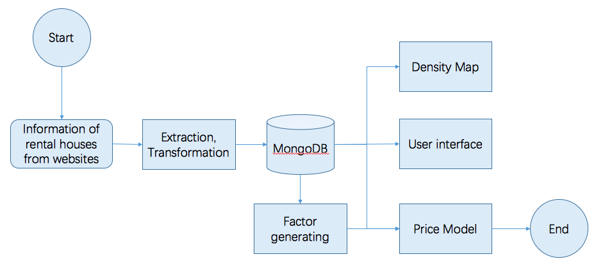
Part 1. Introduction
WorkFlow

Slide 7
CONTENTS
PART 1
PART 2
PART 3
PART 4
Data Crawling & Storage

Slide 8
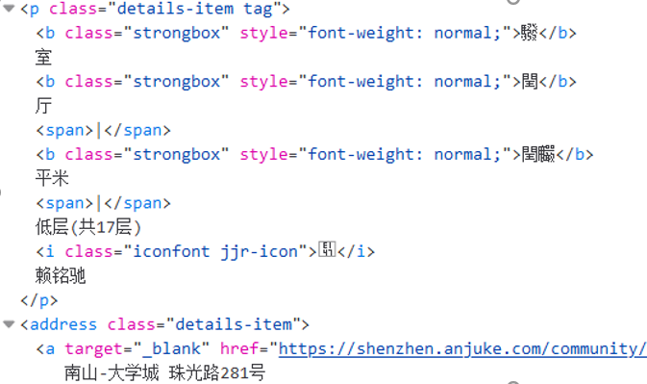
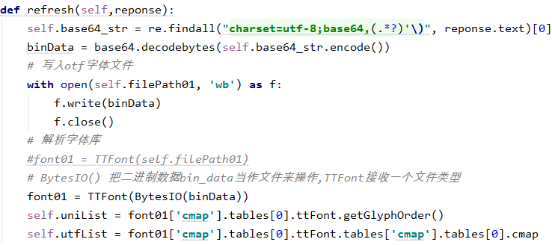
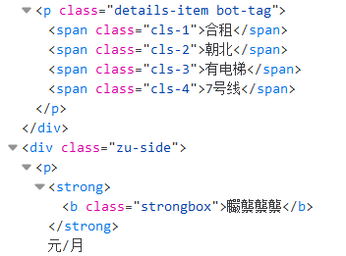
Part 2. Data Crawling & Storage
2.1 Data crawling
Data is encrypted by base64
The font file is encrypted by Base64.
Base64 is a group of binary-to-text encoding schemes that represent binary data in an ASCII string format by translating it into a radix-64 representation.
The mapping order in the font encryption file may change each time when the page is refreshed
Rooms
Living
Rooms
Area
Price

Slide 9

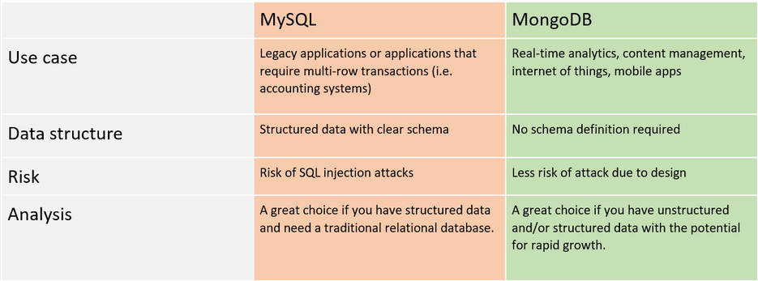
Part 2. Data Crawling & Storage
2.2 Data Storage——MongoDB
At the beginning of the project, the specific format of data cannot be clearly defined.
Return value of Amap API is Json which is much easier to use in MongoDB than MySQL
Storing hot data in physical memory makes the reading and writing of hot data very fast
MongoDB Compass Community 1.20.4

Slide 10
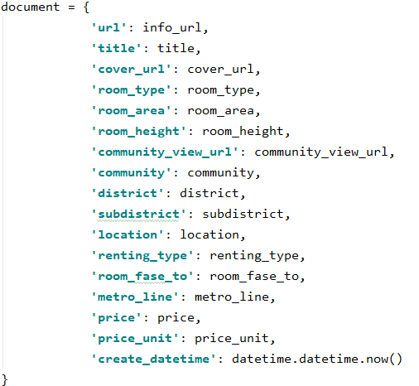
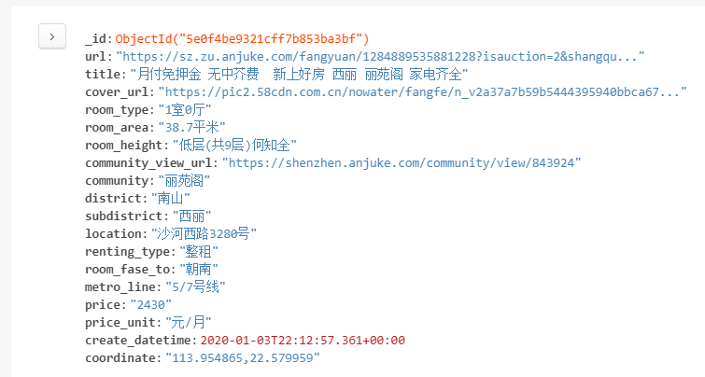
Part 2. Data Crawling & Storage
2.2 Results of crawling
Data categories crawled from websites
Data in Json-like format is very clear

Slide 11
Part 2 Data Crawling & Storage
2.3 Geographic Information
House Location:
Coordinate of each house location.
Metro Station Location:
Name and address
Coordinate of each metro station location.
Shopping Mall Location:
Name and address
Coordinate of each shopping mall location
Hospital Location:
Name and address
Coordinate of each hospital location.
School Location:
Name and address
Coordinate of each school location.

Slide 12
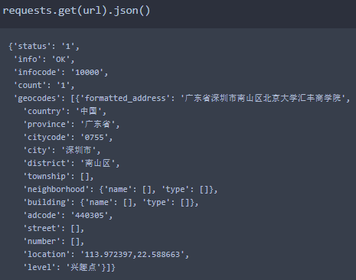
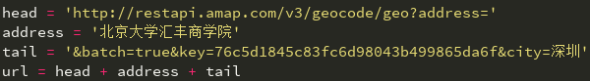
Part 2 Data Crawling & Storage
Amap POI (Point of Interest)
Pinpoint Searching :
Input: City and Location name
Output: JSON geographic data, including coordinate
Method: Query and Crawling
Demo:
Location
Query
Crawling
Coordinate
City

Slide 13
Part 2 Data Crawling & Storage
Amap POI (Point of Interest)
Pinpoint Searching :
Input: City and Location name.
Output: JSON geographic data, including coordinate.
Method: Query and Crawling
Demo:
Location
Query
Crawling
Coordinate
City

Slide 14
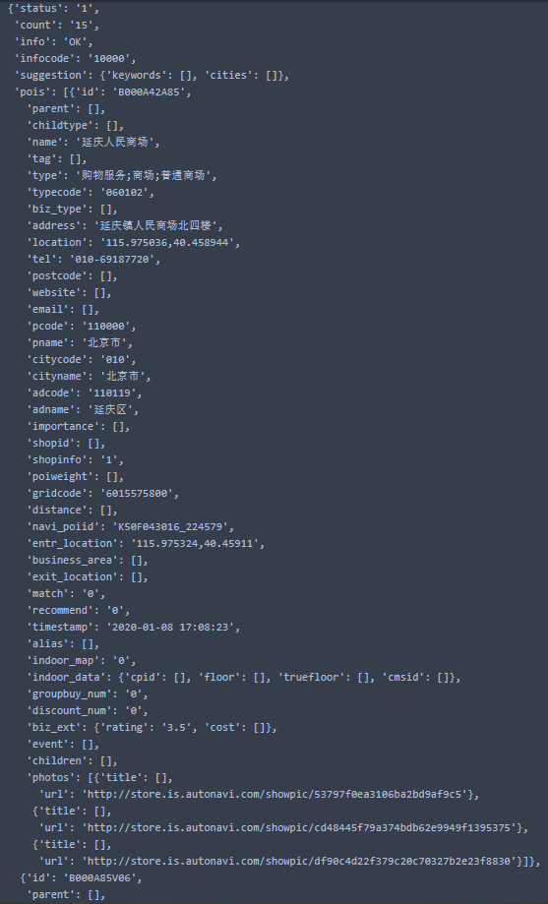
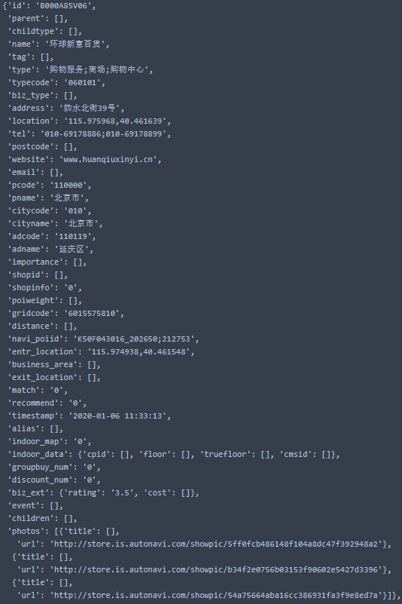
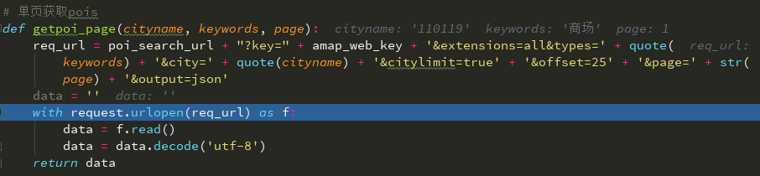
Part 2 Data Crawling & Storage
Amap POI (Point of Interest)
Key-words Searching :
Input: City District and Location Type (Key-words)
Output: JSON geographic data, including coordinate of each location in given district
Method: Query and Crawling
Demo:
…
Input
Output

Slide 15
Part 2 Data Crawling & Storage
Input
…
Output
× 1300

Slide 16
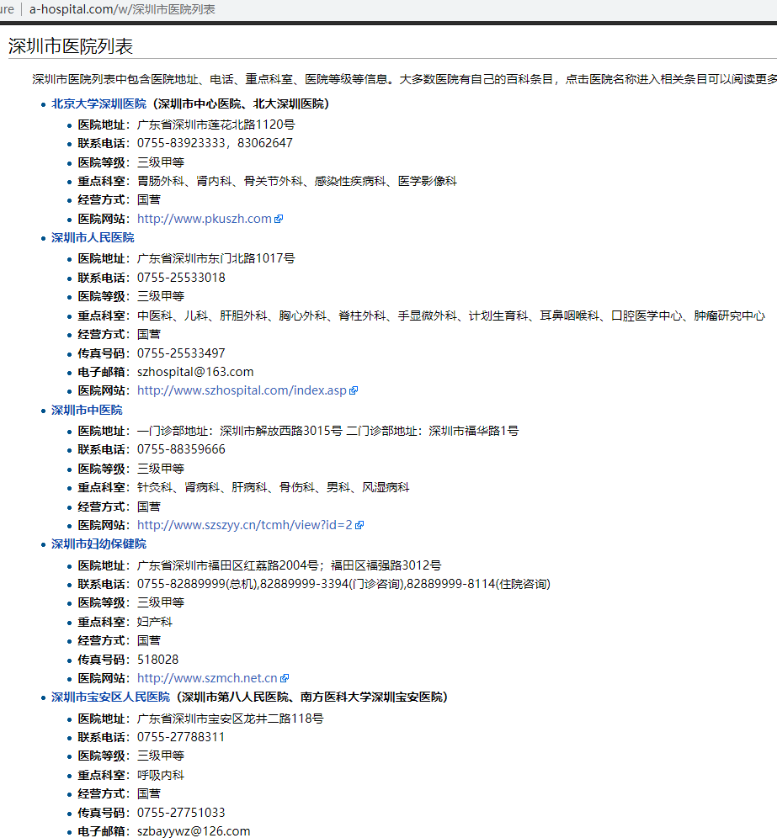
Part 2 Data Crawling & Storage
Data Processing
Shopping Mall Location:
Problem:
About 2,000 malls/markets in Shenzhen.
Solution:
Drop other clustered malls/markets which distances are less than 1km.
Hospital Location:
Problem:
Amap POI Key-words Searching Function includes some small clinic.
Solution:
Crawl hospital names from another website, then use Pinpoint Searching Function to generate coordinate.

Slide 17
Part 2 Data Crawling & Storage
Summary
 | Rent Location | Hospital Location | Metro Station Location | School Location | Shopping Mall Location
Name Resource | MongoDB | http://www.a-hospital.com | Amap POI Query | Amap POI Query | Amap POI Query
Coordinate Resource | Amap POI Query | Amap POI Query | Amap POI Query | Amap POI Query | Amap POI Query
Data Structure | Name: CSV Coordinate: JSON | Name: XML Coordinate: JSON | JSON | JSON | JSON
Instance Amount | 3294 | 139 | 171 | 513 | 310
Rent location name information comes from the first step’s web crawling.
Hospital location name information comes from A-Hospital website.
Other 3 location name information comes from the key-word query function.

Slide 18
CONTENTS
PART 1
PART 2
PART 3
PART 4
Feature Engineering

Slide 19
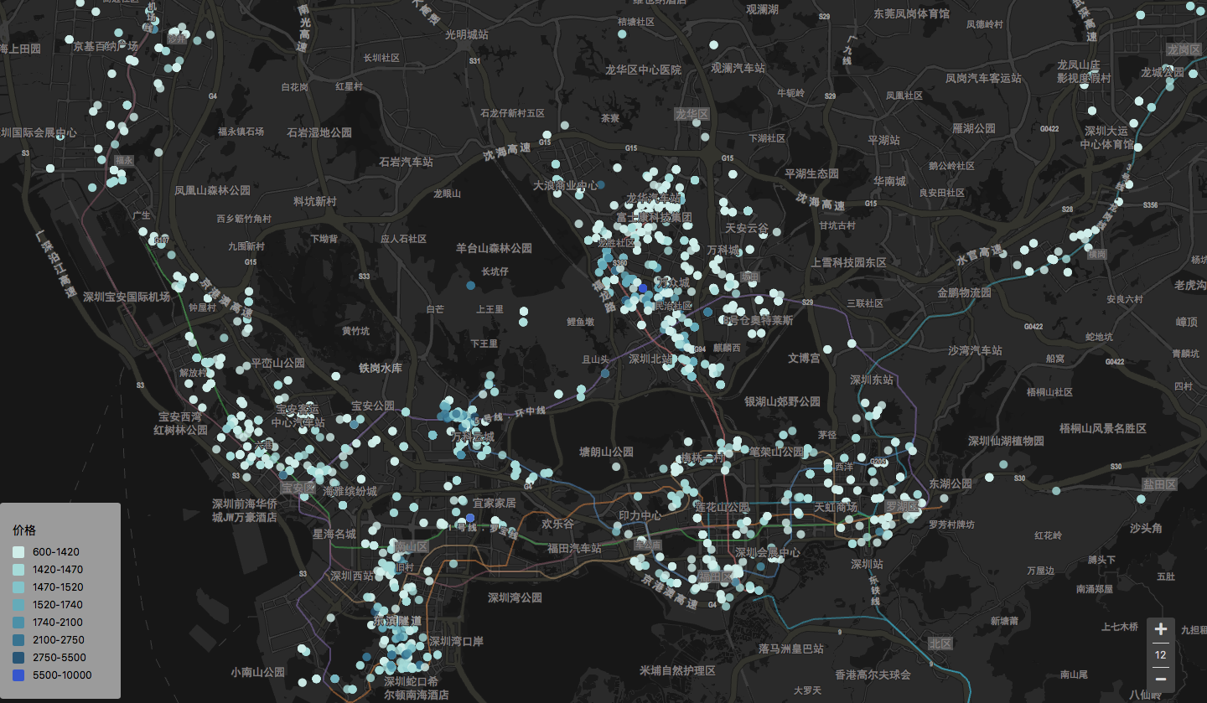
Part 3. Feature_Engineering
3.1Visualization
Use AMAP API to visualization by html language in the website (lbs.amap.com)
This picture shows the distribution of the renting houses and the prices.
It is clear that the renting houses are focus on certain areas.
The prices level distance are not quietly large in different areas, but the prices level seems to be high in dense area. This may because that the demand are also high there.

Slide 20
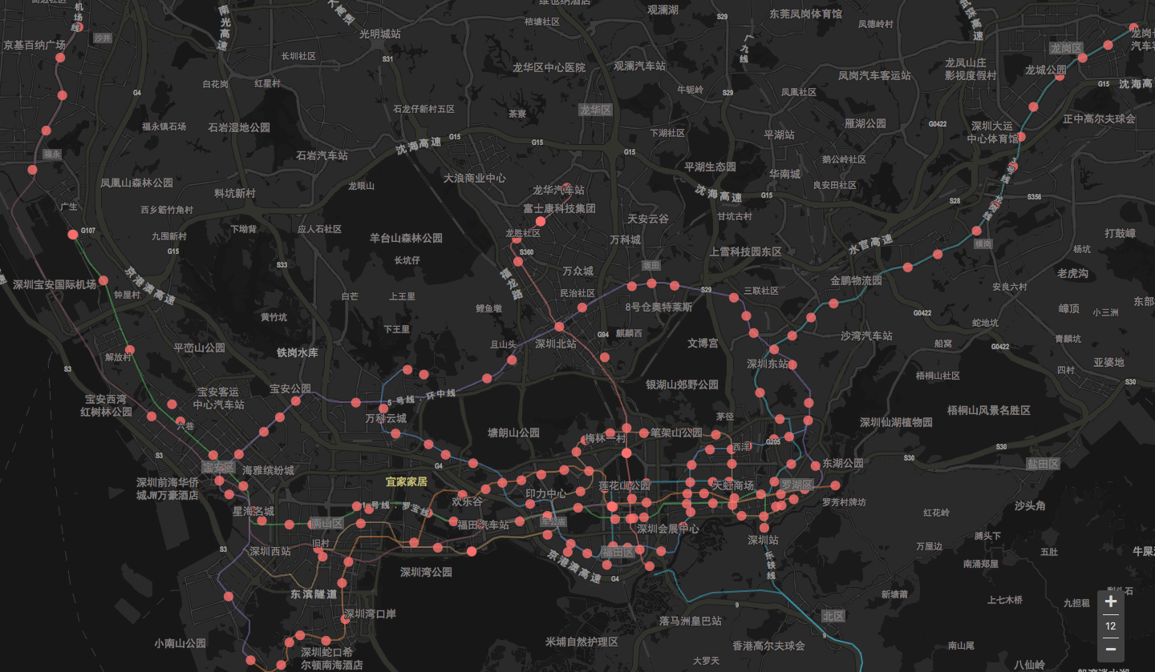
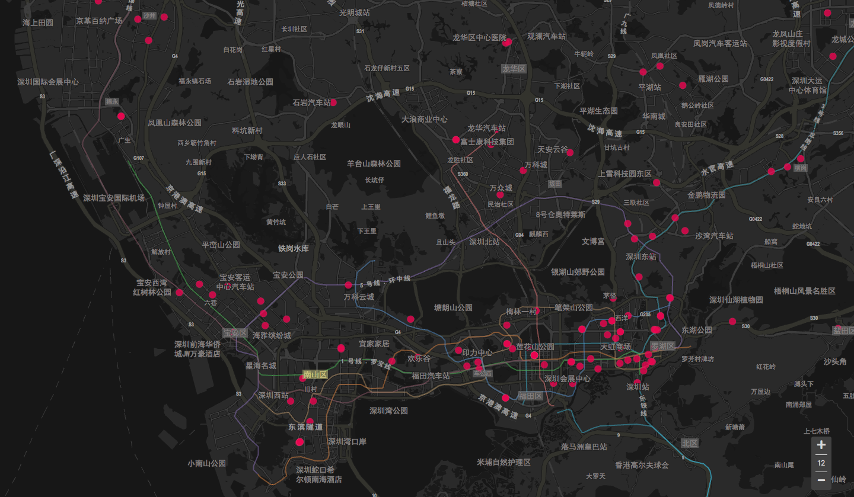
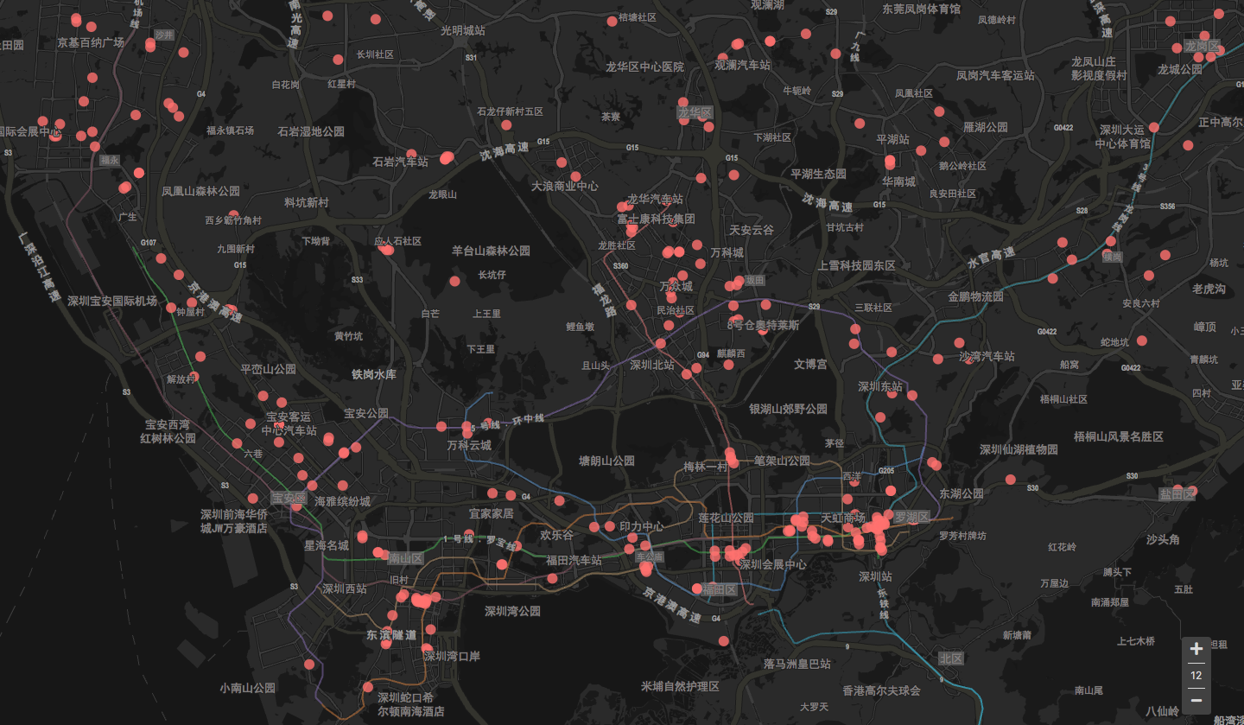
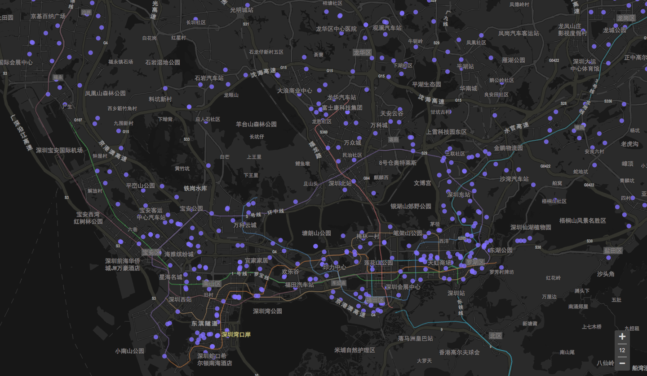
Part 3. Feature_Engineering
3.1Visualization(cont.)
This is the distribution of metro lines, hospital, shopping malls and school.
However, it is hard to see whether the distances to these services could affect the renting prices and we need to calculate the distances in detail.
Metro Stations
Hospital
Shopping Malls
School

Slide 21
Part 3. Feature_Engineering
3.2Feature generation
Renting houses information
Room type | Room area | Room height | Building height | Renting type | Room face | Price | Longitude | latitude | Address
Three bedrooms and one living rooms | 19 Square meters | Middle | 7 floors | Whole | East | 1900 | 114.0192 | 22.6325 | 3208#, Sha He Road, Xi Li, Nan Shan
Services information
Services | Location | Remarks | Sample size
Metro lines | Longitude and latitude | Lines number | 513
Shopping Mall | Longitude and latitude | Type | 330
Hospital | Longitude and latitude | - | 171
School | Longitude and latitude | Type | 139

Slide 22
Part 3. Feature_Engineering
3.2Feature generation(cont.)
Renting houses information
Room type | Room area | Room height | Building height | Renting type | Room face | Price | Longitude | Latitude | Address
Three bedrooms and one living rooms | 19 Square meters | Middle | 7 floors | Whole | East | 1900 | 114.0192 | 22.6325 | 3208#, Sha He Road, Xi Li, Nan Shan
Process methods
Separate the number of bedrooms and living rooms as different variables
Just use room area
Change the Room height to the dummy variables(Low, Middle, High)
Just use the building height
Change the Room face to the dummy variables (east, west, south-east…)
Change the district to dummy variables (Nan Shan, Fu Tian, Luo Hu…)
Calculate the distance from the nearest metro line stations and how many stations less than 1 km
Shopping malls, Schools, Hospital are just the same

Slide 23
Part 3. Feature_Engineering
3.2Feature generation(cont.)
Feature Name | Type | Feature Name | Type
num_bed_room | Float | hosp_distance | Float
num_living_room | Float | hosp_number | Float
room_area | Float | school_distance | Float
total_height | Float | school_number | Float
metro_distance | Float | height_type_low | Dummy
metro_number | Float | height_type_high | Dummy
CBD_distance | Float | room_face_type_east | Dummy
CBD_number | Float | …
renting_type_whole | Dummy | district_NanShan | Dummy
 |  | …
There are total 33 features and the model can tell which variables are redundant

Slide 24
CONTENTS
PART 1
PART 2
PART 3
PART 4
Model

Slide 25
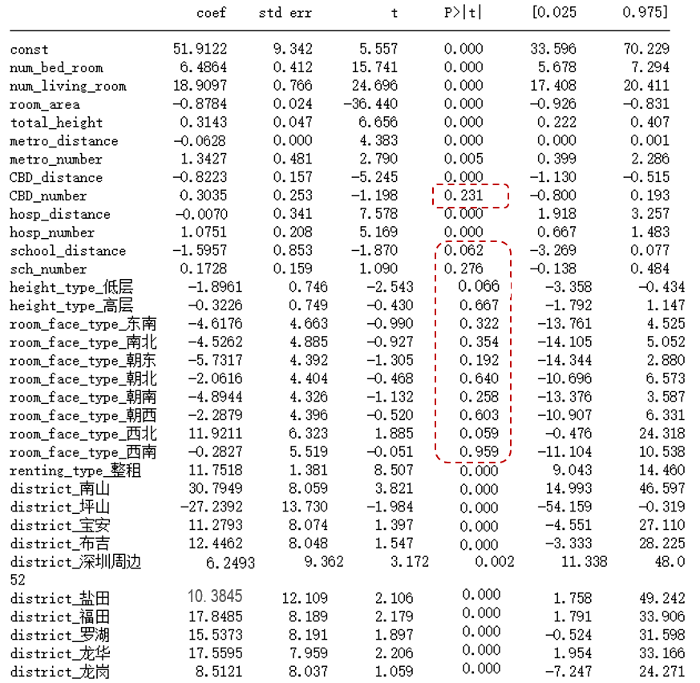
Part 4. Model
4.1 OLS
R-squared: 0.898
Adj. R-squared: 0.897
The rent is positively related to the number of living room and bedroom, the total height of the building and the number of metro, CBD, and hospital within 1 km.
The rent is negatively related to the distance to metro, CBD, hospital and the room area.
The whole rent is more expensive than joint rent.
Relatively, Nanshan District has the highest rent and Pingshan District has the lowest rent.
The distance to school, the number of school and CBD within 1 km, room face as well as the floor are not significant for rent.
Notes:
Apartment bungalow
The closer to CBD, the higher the rent.
Housing Price-to-Income Ratio

Slide 26
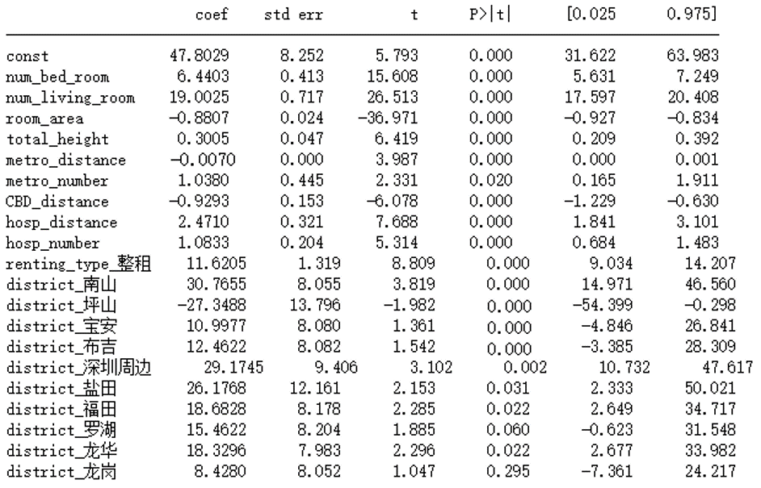
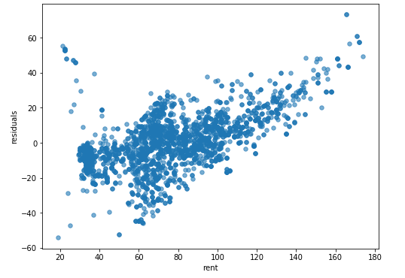
Part 4. Model
4.2 Deleting the insignificant variables
Setting significance level α=0.05, we delete 13 insignificant variables and do the OLS again.
R-squared: 0.898 Adj. Rsquared: 0.897
Notes:
Interpretability

Slide 27
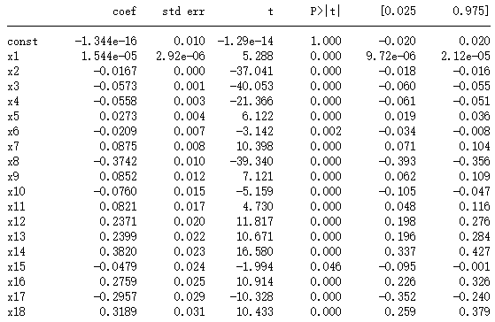
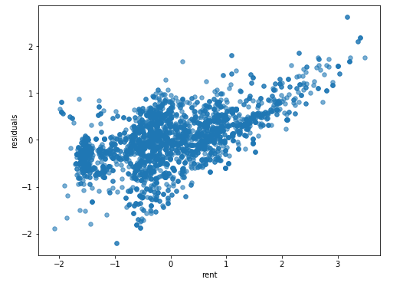
Part 4. Model
4.3 PCA
Selecting the first 18 principal components, the contributions of which has reached 0.9999.
R-squared: 0.890 Adj. Rsquared: 0.889
Notes:
Reduce dimension
High fitting degree

Slide 28
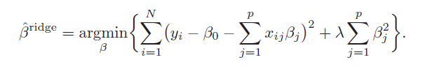
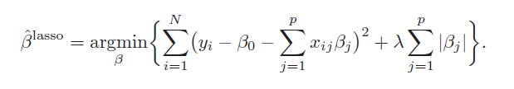
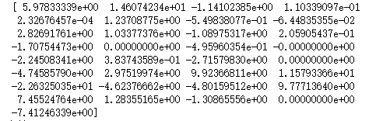
Part 4. Model
4.4 Ridge & LASSO
Ridge
LASSO
Use five different λ: 0.001, 0.01, 0.1, 1, 10 to train the model and get the best λ=0.1.
The coefficients matrix
Use five different λ: 0.001, 0.01, 0.1, 1, 10 to train the model and get the best λ=0.001.
R-squared: 0.889
Adj. R-squared: 0.884
R-squared: 0.895
Adj. R-squared: 0.894
Notes:
Cross validation to train the model with five different lambda
Four coefficients are set to be zero

Slide 29
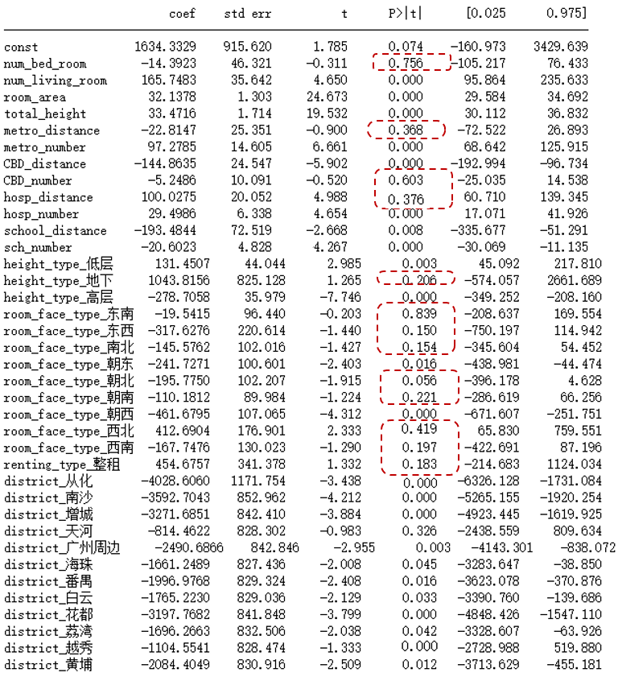
Part 4. Model
4.5 Guangzhou
R-squared: 0.776
Adj. R-squared: 0.773
The rent is positively related to the number of living room, the room area, the total height of the building and the number of metro, hospital, and school within 1 km.
The rent is negatively related to the distance to CBD and school.
The low floor rent is more expensive than high floor.
Relatively, Tianhe District has the highest rent and Conghua District has the lowest rent.
The house facing west is least popular cause Guangzhou is too hot in summer.
Notes:
3:
Renting behavior: More Village in city, relatively cheaper, prefer to rent lager room.
More elder people in GZ, the lower floor is more convenient for them.

Slide 30
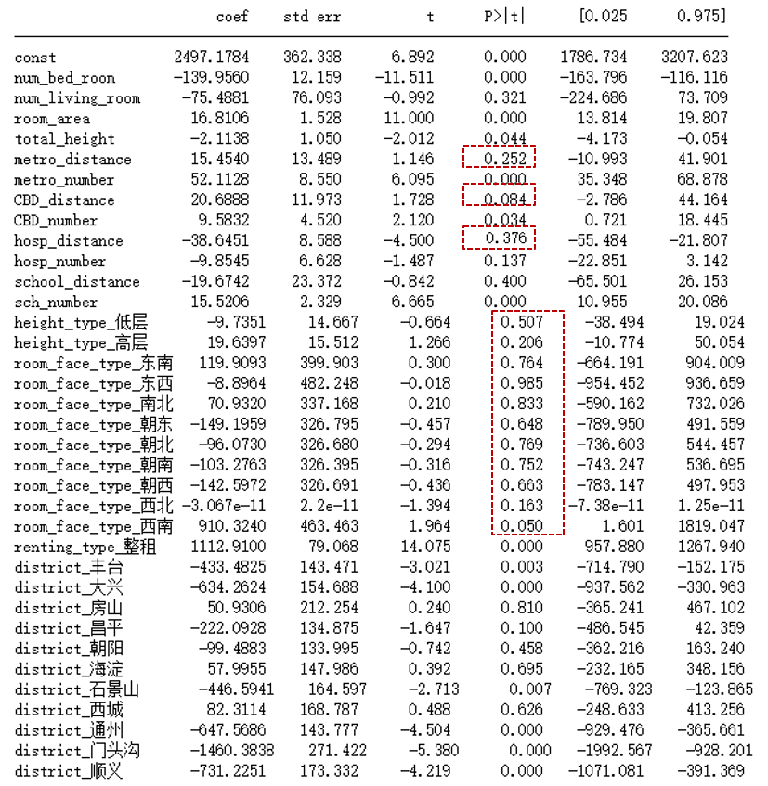
Part 4. Model
4.5 Beijing
R-squared: 0.560
Adj. R-squared: 0.556
The whole renting is more popular.
The school district room is a key consideration for tenants.
Relatively, Xicheng District has the highest rent and Mengtougou has the lowest rent.
There are some other unknown factors in Beijing that lead to unreasonable house price, like speculation.
Notes:
School district room is high
Weight weaken the effect of other factors.

Slide 31
Part 5. Conclusion
Find the influence factors that explain the rent or house price and try to predict it in future data.
Find people’s different preferences when they choose to rent a house.
This can also provide the basis for further investigation and research for specific cities.

Slide 32
Thank You for your attention!

